Slide 1

Analyzing Audience

Slide 2

Definition of Term
▶ In Professional Writing, audience refers to READERS who will be reading the documents you prepare.
▶ E.g. Your boss, clients, supervisors, colleagues, staff from other departments, government officials, media and etc.

Slide 3
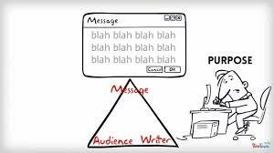
Understanding Audience
▶ Your content/documents are deemed comprehensive only if they are composed based on:
▶ accurate understanding of the needs of the audiences
▶ clear content (including 4Cs), focused purpose

Slide 4

Audience
▶ Writers at times classify readers into categories that identify each reader’s distance from the writer
Primary
Secondary
Tertiary

Slide 5
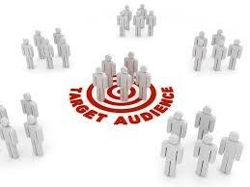
Primary Audience
Your primary audience is your intended audience; it is the person or group that you have in mind when you decide to communicate something
People whom communication is directed- People within the organization or outside the writer’s organization
The most important group to the writer

Slide 6

Secondary Audience
Consists of people more distant from the writer who need to stay aware of the message/developments in the organization but who will not directly act or respond to the document.
Secondary audience might include readers of your document who might be interested/not interested in buying your product. They need to stay aware of what’s happening.

Slide 7
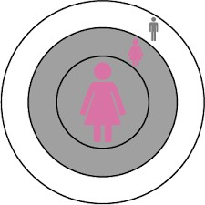
Tertiary Audience
Consists of people further removed from the writer who might take an interest in the subject/message
Tertiary audiences are those who have a general interest or stake in your information, such as competitors, media, or public.
▶ Media
▶ Local, state and federal government agencies
▶ General public ( if the message is made public)

Slide 8
INTERNAL VS EXTERNAL AUDIENCE
Internal: people in the same organization
Subordinates
Supervisors
Peers
External: people outside the organization
Customers/Suppliers/Stockholders
Unions/Government Agencies
Press/General Public

Slide 11



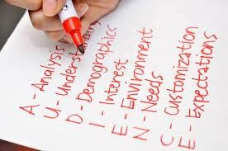


Audience Analysis
Demographic Analysis
Situational Analysis
Psychographic Analysis

Slide 12
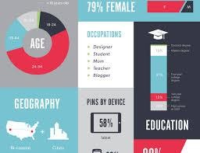
Demographics Analysis
▶ Demographic/s information includes factors such as gender, age range, marital status, race and ethnicity, education and socioeconomic status and etc.
▶ Demographic analysis explain the basic information of your audience

Slide 13
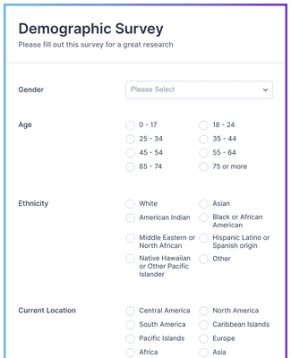
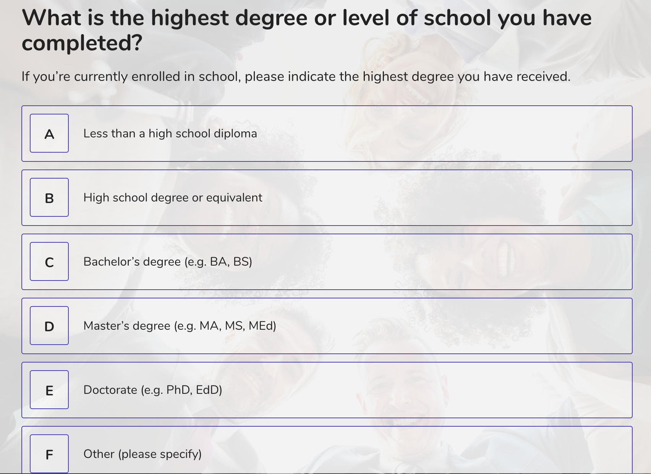

Slide 14

Psychographics Analysis
▶ Psychographic/s information includes things such as values, opinions, attitudes, and beliefs.

Slide 15
▶ A psychographic profile is a unique description of the attitudes, habits, and interests of an individual or group
PSYCHOGRAPHICS | DEMOGRAPHICS
Personality Characteristics | Age
Lifestyle | Gender
Social Class | Occupation
Habits | Ethnicity
Beliefs | Education Level
Behaviors | Religion
Interests

Slide 16
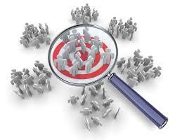
Situational Analysis
▶ It focuses on characteristics related to the specific reading situation

Slide 17
How will the readers use your
document
The way your reader will read your document
Your reader’s reading skill
The physical environment/digital environment in which your reader will read your document

Slide 18
Conclusion
▶ A helpful way of gathering information about your readers is to conduct an audience analysis
▶ Depending on the purpose and needs of your documents, you may perform a brief audience profile or an in-depth audience analysis (or something in between)
▶ Remember the more you know about your potential readers, the more
persuasive and user-centered your documents may be

